Slide 1
RL and GAN for Sentence Generation and Chat-bot
Hung-yi Lee

Slide 2
Outline
RF for chat-bot
Human provides feedback
GAN for chat-bot
Machine (discriminator) provides feedback
Rewarding for Every Generation Step
MCMC
Rewarding Partial Decoded Sequence

Slide 3
Review: Chat-bot
Sequence-to-sequence learning
A: ∆ ∆ ∆
output sentence
Training data:
……
A: OOO
Encoder
Generator
B: XXX
A: ∆ ∆ ∆
history information
Input sentence
……
A: OOO
B: XXX

Slide 4
Review: Encoder
to generator
Encoder
你
好
嗎
我
很
好
Hierarchical Encoder

Slide 5
Review: Generator
B
A
A
A
A
A
B
B
B
<BOS>
A
B
: condition from decoder
can be different with attention mechanism
Notes:
Testing: Output of model is the input of the next step.
Training: the inputs are reference.
Exposure Bias

Slide 6

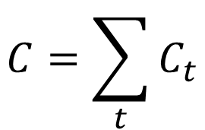


Review: Training Generator
A
Reference:
B
B
$$C=\sum_{t}{C_{t}}$$
$$C_{1}$$
$$C_{2}$$
$$C_{3}$$
A
A
A
Minimizing cross-entropy of each component
B
B
B
: condition from decoder
<BOS>
A
B

Slide 7

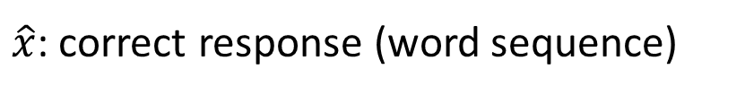


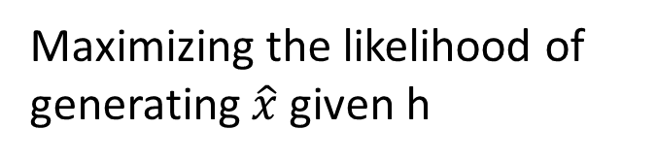
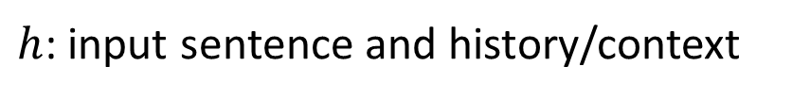



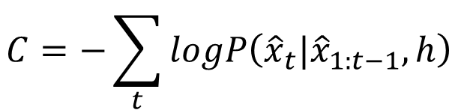

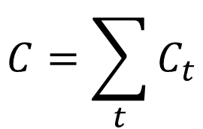




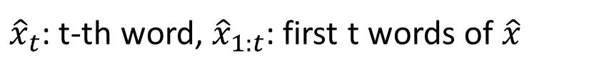
Review: Training Generator
Training data:
$$\left(h,\hat{x}\right)$$
$h$: input sentence and history/context
$\hat{x}$: correct response (word sequence)
$$C=\sum_{t}{C_{t}}$$
${\hat{x}}_{t}$: t-th word, ${\hat{x}}_{1:t}$: first t words of $\hat{x}$
$$C_{t}=−logP_{θ}\left({\hat{x}}_{t}|{\hat{x}}_{1:t−1},h\right)$$
$${\hat{x}}_{t−1}$$
$${\hat{x}}_{t}$$
$${\hat{x}}_{t+1}$$
$$C=−\sum_{t}{logP\left({\hat{x}}_{t}|{\hat{x}}_{1:t−1},h\right)}$$
……
……
$$C_{t−1}$$
$$C_{t}$$
$$C_{t+1}$$
$$=−logP\left({\hat{x}}_{1}|h\right)P\left({\hat{x}}_{t}|{\hat{x}}_{1:t−1},h\right)$$
$$⋯P\left({\hat{x}}_{T}|{\hat{x}}_{1:T−1},h\right)$$
……
……
$$=−logP\left(\hat{x}|h\right)$$
Maximizing the likelihood of generating $\hat{x}$ given h
generator output

Slide 8
RL for Sentence Generation
Jiwei Li, Will Monroe, Alan Ritter, Michel Galley, Jianfeng Gao, Dan Jurafsky, “Deep Reinforcement Learning for Dialogue Generation“, EMNLP 2016
Notes:
Deep Reinforcement Learning for Dialogue Generation

Slide 9


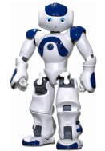


Introduction
https://image.freepik.com/free-vector/variety-of-human-avatars_23-2147506285.jpg
http://www.freepik.com/free-vector/variety-of-human-avatars_766615.htm
Machine obtains feedback from user
Chat-bot learns to maximize the expected reward
How are you?
Hello
Bye bye ☺
Hi ☺
-10
3
Notes:
Consider that you have a non-differentiable objective function
This is cost!
Ignore multiple turns here

Slide 10


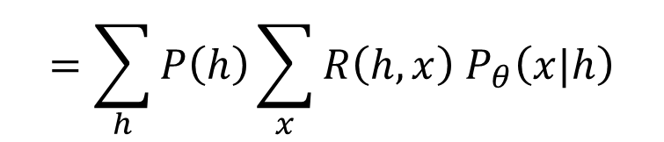




Maximizing Expected Reward
Encoder
Generator
Human
$$h$$
$$x$$
$$R\left(h,x\right)$$
update
$$θ$$
$$θ^{∗}=arg\max_{θ}{{\overline{R}}_{θ}}$$
Maximizing expected reward
$$=\sum_{h}{P\left(h\right)\sum_{x}{R\left(h,x\right) P_{θ}\left(x|h\right)}}$$
$${\overline{R}}_{θ}$$
Randomness in generator
Probability that the input/history is h

Slide 11
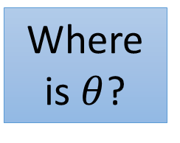


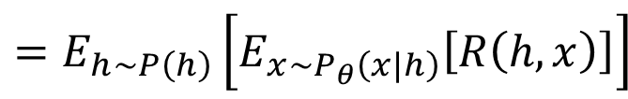

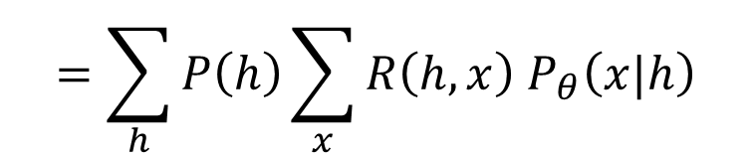

Maximizing Expected Reward
Encoder
Generator
Human
$$h$$
$$x$$
$$R\left(h,x\right)$$
update
$$θ$$
$$θ^{∗}=arg\max_{θ}{{\overline{R}}_{θ}}$$
Maximizing expected reward
$$=\sum_{h}{P\left(h\right)\sum_{x}{R\left(h,x\right) P_{θ}\left(x|h\right)}}$$
$$=E_{h\sim P\left(h\right)}\left[E_{x\sim P_{θ}\left(x|h\right)}\left[R\left(h,x\right)\right]\right]$$
$${\overline{R}}_{θ}$$
$$≈\frac{1}{N}\sum_{i=1}^{N}{R\left(h^{i},x^{i}\right)}$$
$$=E_{h\sim P\left(h\right),x\sim P_{θ}\left(x|h\right)}\left[R\left(h,x\right)\right]$$
Where is $θ$?
Sample:
$$\left(h^{1},x^{1}\right),\left(h^{2},x^{2}\right),⋯,\left(h^{N},x^{N}\right)$$

Slide 12
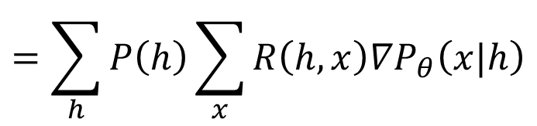
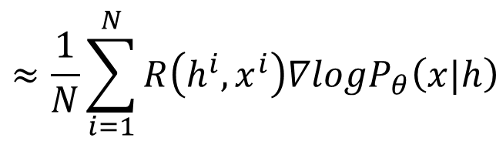

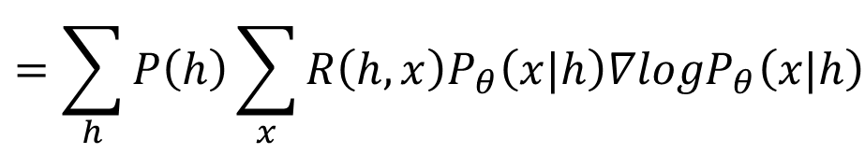

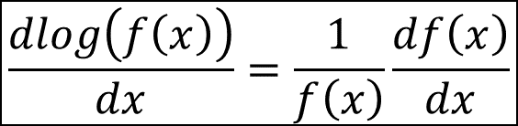

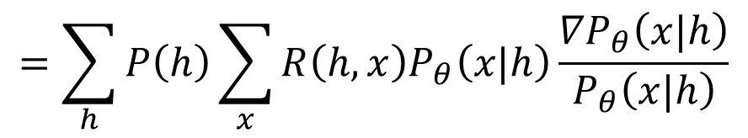
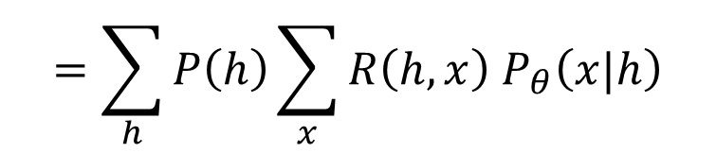
Policy Gradient
$$\frac{dlog\left(f\left(x\right)\right)}{dx}=\frac{1}{f\left(x\right)}\frac{df\left(x\right)}{dx}$$
$$=\sum_{h}{P\left(h\right)\sum_{x}{R\left(h,x\right) P_{θ}\left(x|h\right)}}$$
$$≈\frac{1}{N}\sum_{i=1}^{N}{R\left(h^{i},x^{i}\right)}$$
$${\overline{R}}_{θ}$$
$$≈\frac{1}{N}\sum_{i=1}^{N}{R\left(h^{i},x^{i}\right){∇logP}_{θ}\left(x|h\right)}$$
$$=\sum_{h}{P\left(h\right)\sum_{x}{R\left(h,x\right){∇P}_{θ}\left(x|h\right)}}$$
$$∇{\overline{R}}_{θ}$$
$$=\sum_{h}{P\left(h\right)\sum_{x}{R\left(h,x\right)P_{θ}\left(x|h\right)\frac{{∇P}_{θ}\left(x|h\right)}{P_{θ}\left(x|h\right)}}}$$
Sampling
$$=\sum_{h}{P\left(h\right)\sum_{x}{R\left(h,x\right)P_{θ}\left(x|h\right){∇logP}_{θ}\left(x|h\right)}}$$
$$=E_{h\sim P\left(h\right),x\sim P_{θ}\left(x|h\right)}\left[R\left(h,x\right){∇logP}_{θ}\left(x|h\right)\right]$$

Slide 13
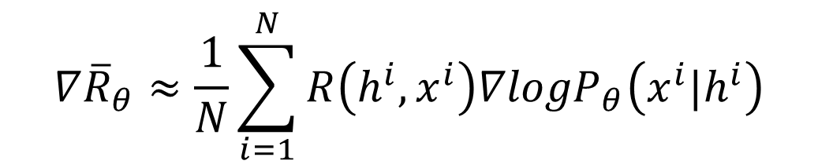


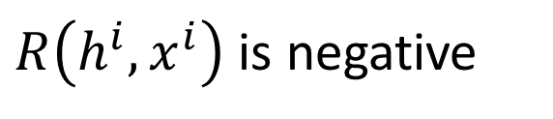

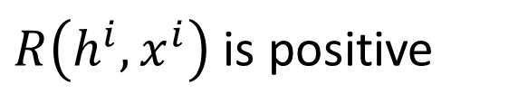
Policy Gradient
Gradient Ascent
$$θ^{new}←θ^{old}+η∇{\overline{R}}_{θ^{old}}$$
$$∇{\overline{R}}_{θ}≈\frac{1}{N}\sum_{i=1}^{N}{R\left(h^{i},x^{i}\right){∇logP}_{θ}\left(x^{i}|h^{i}\right)}$$
$R\left(h^{i},x^{i}\right)$ is positive
After updating $θ$, $P_{θ}\left(x^{i}|h^{i}\right)$will increase
$R\left(h^{i},x^{i}\right)$ is negative
After updating $θ$, $P_{θ}\left(x^{i}|h^{i}\right)$will decrease

Slide 14

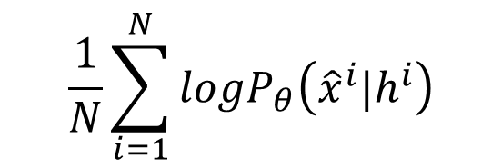
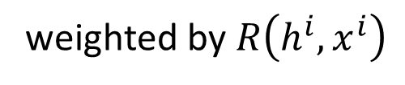

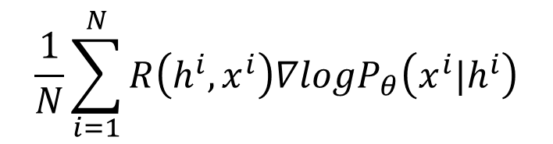


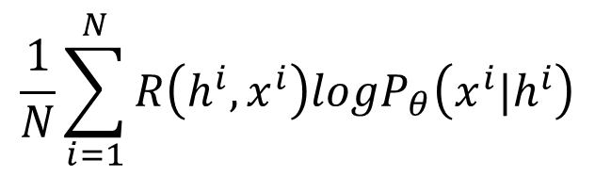

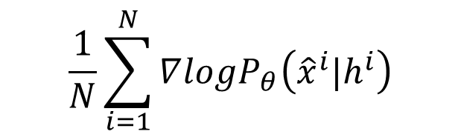

Implementation
$$h^{i}$$
Encoder
Genera
tor
$$x^{i}$$
Human
$R\left(h^{i},x^{i}\right)$
Maximum Likelihood
Reinforcement Learning
$$\frac{1}{N}\sum_{i=1}^{N}{{logP}_{θ}\left({\hat{x}}^{i}|h^{i}\right)}$$
$$\frac{1}{N}\sum_{i=1}^{N}{R\left(h^{i},x^{i}\right){logP}_{θ}\left(x^{i}|h^{i}\right)}$$
Objective
Function
$$\frac{1}{N}\sum_{i=1}^{N}{∇{logP}_{θ}\left({\hat{x}}^{i}|h^{i}\right)}$$
$$\frac{1}{N}\sum_{i=1}^{N}{R\left(h^{i},x^{i}\right){∇logP}_{θ}\left(x^{i}|h^{i}\right)}$$
Gradient
Training
Data
$$\left\{\left(h^{1},{\hat{x}}^{1}\right),…,\left(h^{N},{\hat{x}}^{N}\right)\right\}$$
$$\left\{\left(h^{1},x^{1}\right),…,\left(h^{N},x^{N}\right)\right\}$$
$$R\left(h^{i},{\hat{x}}^{i}\right)=1$$
Sampling as training data
weighted by $R\left(h^{i},x^{i}\right)$

Slide 15

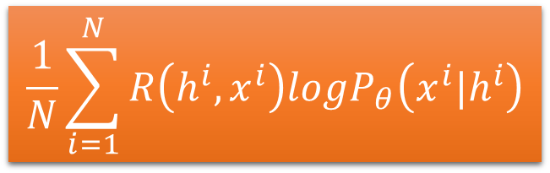



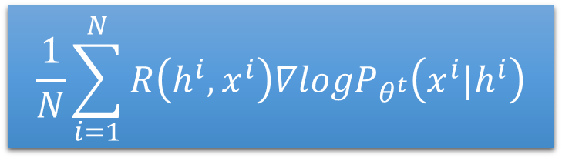





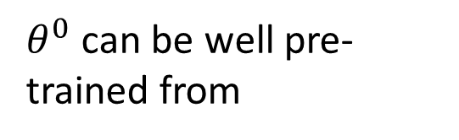
Implementation
$θ^{0}$ can be well pre-trained from
$$\left\{\left(h^{1},{\hat{x}}^{1}\right),…,\left(h^{N},{\hat{x}}^{N}\right)\right\}$$
New Objective:
$$θ^{t}$$
$$\frac{1}{N}\sum_{i=1}^{N}{R\left(h^{i},x^{i}\right){logP}_{θ}\left(x^{i}|h^{i}\right)}$$
$$\left(h^{1},x^{1}\right)$$
$$R\left(h^{1},x^{1}\right)$$
$$θ^{t+1}←θ^{t}+η∇{\overline{R}}_{θ^{t}}$$
$$\left(h^{2},x^{2}\right)$$
$$R\left(h^{2},x^{2}\right)$$
……
……
$$\frac{1}{N}\sum_{i=1}^{N}{R\left(h^{i},x^{i}\right){∇logP}_{θ^{t}}\left(x^{i}|h^{i}\right)}$$
$$\left(h^{N},x^{N}\right)$$
$$R\left(h^{N},x^{N}\right)$$

Slide 16

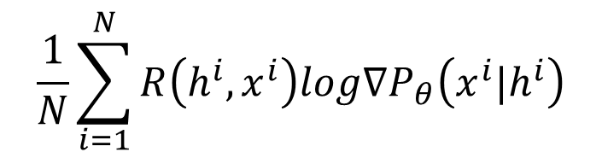
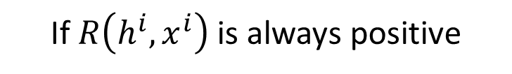
Add a Baseline
If $R\left(h^{i},x^{i}\right)$ is always positive
$$\frac{1}{N}\sum_{i=1}^{N}{R\left(h^{i},x^{i}\right){log∇P}_{θ}\left(x^{i}|h^{i}\right)}$$
Because it is probability …
Ideal
case
$$P_{θ}\left(x|h\right)$$
(h,x¹)
(h,x²)
(h,x³)
(h,x¹)
(h,x²)
(h,x³)
Not sampled
Due to
Sampling
(h,x¹)
(h,x²)
(h,x³)
(h,x¹)
(h,x²)
(h,x³)

Slide 17
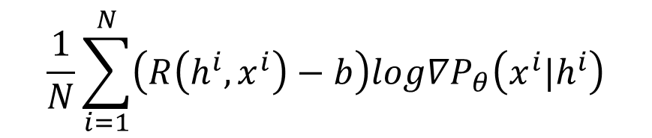

Add a Baseline
If $R\left(h^{i},x^{i}\right)$ is always positive
$$\frac{1}{N}\sum_{i=1}^{N}{R\left(h^{i},x^{i}\right){log∇P}_{θ}\left(x^{i}|h^{i}\right)}$$
$$\frac{1}{N}\sum_{i=1}^{N}{\left(R\left(h^{i},x^{i}\right)−b\right){log∇P}_{θ}\left(x^{i}|h^{i}\right)}$$
Not sampled
$$P_{θ}\left(x|h\right)$$
Add
baseline
(h,x¹)
(h,x²)
(h,x³)
(h,x¹)
(h,x²)
(h,x³)
There are several ways to obtain the baseline b.

Slide 18

Alpha GO style training !
Let two agents talk to each other
How old are you?
How old are you?
See you.
I am 16.
See you.
I though you were 12.
See you.
What make you think so?
Using a pre-defined evaluation function to compute R(h,x)
Notes:
(sometimes generate good dialogue, sometimes bad)
Integrate the method of Reinforcement Learning
To model the future reward
Simulate dialogue between two virtual agent
Using policy-gradient method to reward sequence with 3 properties
Informativity
Coherence
Ease of answering

Slide 19
Example Reward
The final reward R(h,x) is the weighted sum of three terms r₁(h,x), r₂(h,x) and r₃(h,x)
$$R\left(h,x\right)={\text{λ}}_{1}r_{1}\left(h,x\right)+{\text{λ}}_{2}r_{2}\left(h,x\right)+{\text{λ}}_{3}r_{3}\left(h,x\right)$$
Ease of answering
Information
Flow
Semantic
Coherence
不要成為句點王
說點
新鮮的
不要前言不對後語
Notes:
Mutual information?
Pre-train is needed

Slide 20
Example Results
Notes:
RL model end sentence with another question

Slide 21
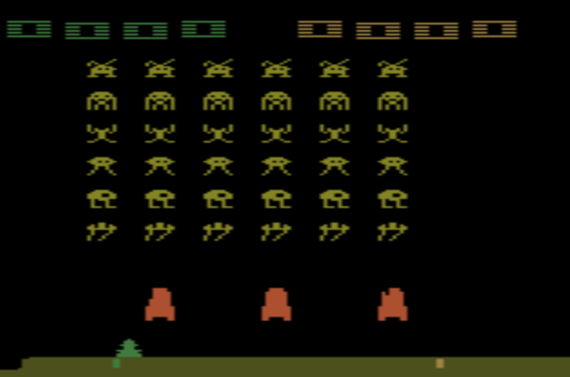
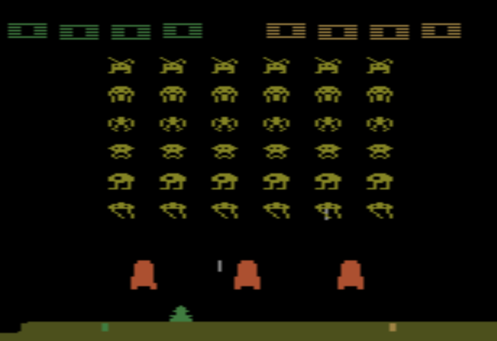
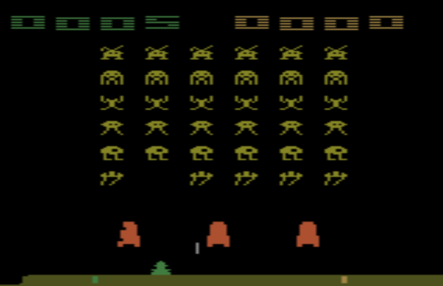

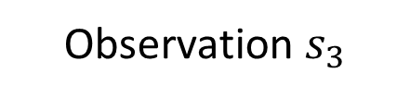
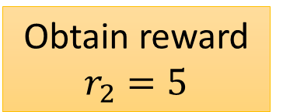
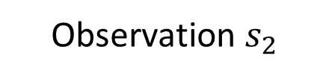
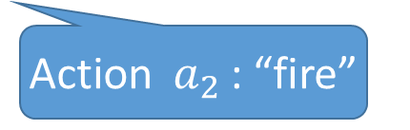
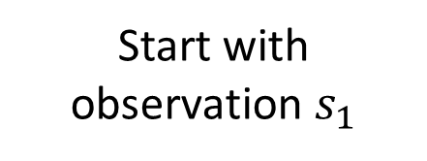
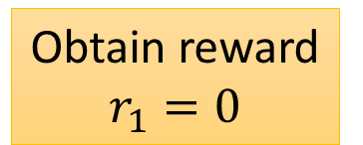
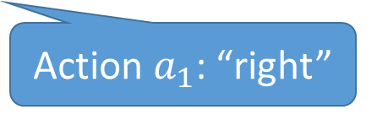
Reinforcement learning?
Start with observation $s_{1}$
Observation $s_{2}$
Observation $s_{3}$
Obtain reward $r_{1}=0$
Obtain reward $r_{2}=5$
Action $a_{1}$: “right”
Action $a_{2}$: “fire”
(kill an alien)
Notes:
SEQUENCE LEVEL TRAINING

Slide 22



Reinforcement learning?
$$reward:$$
R(“BAA”, reference)
$r=0$
$r=0$
Action taken
B
A
A
A
A
A
Actions set
B
B
B
observation
A
<BOS>
B
Marc'Aurelio Ranzato, Sumit Chopra, Michael Auli, Wojciech Zaremba, “Sequence Level Training with Recurrent Neural Networks”, ICLR, 2016
The action we take influence the observation in the next step

Slide 23
Reinforcement learning?
One can use any advanced RL techniques here.
For example, actor-critic
Dzmitry Bahdanau, Philemon Brakel, Kelvin Xu, Anirudh Goyal, Ryan Lowe, Joelle Pineau, Aaron Courville, Yoshua Bengio. "An Actor-Critic Algorithm for Sequence Prediction." ICLR, 2017.

Slide 24
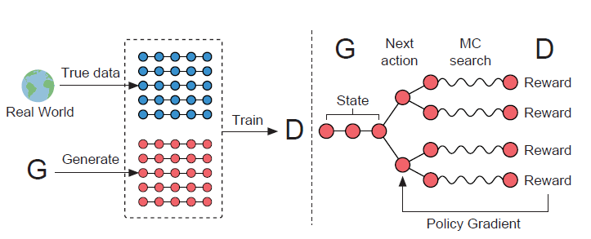
SeqGAN
Lantao Yu, Weinan Zhang, Jun Wang, Yong Yu, “SeqGAN: Sequence Generative Adversarial Nets with Policy Gradient”, AAAI, 2017
Jiwei Li, Will Monroe, Tianlin Shi, Sébastien Jean, Alan Ritter, Dan Jurafsky, “Adversarial Learning for Neural Dialogue Generation”, arXiv preprint, 2017
Notes:
Deep Reinforcement Learning for Dialogue Generation

Slide 25
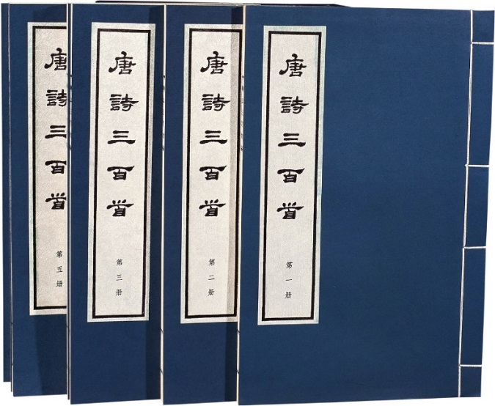
Basic Idea – Sentence Generation
code z sampled from prior distribution
Generator
sentence x
Sampling from RNN at each time step also provides randomness
Discriminator
sentence x
Real or fake
Original GAN
Notes:
Different of two kinds of generator

Slide 26


Algorithm – Sentence Generation
Initialize generator Gen and discriminator Dis
In each iteration:
Sample real sentences $x$ from database
Generate sentences $\tilde{x}$ by Gen
Update Dis to increase $Dis\left(x\right)$ and decrease $Dis\left(\tilde{x}\right)$
Update Gen such that
Generator
Discrimi
nator
scalar
update
Notes:
Gen is pre-trained by typical approach
Not gradient!

Slide 27

Basic Idea – Chat-bot
http://www.nipic.com/show/3/83/3936650kd7476069.html
Input sentence/history h
En
De
response sentence x
Chatbot
Input sentence/history h
Discriminator
Real or fake
response sentence x
Conditional GAN
human
dialogues

Slide 28


Algorithm – Chat-bot
Training data:
……
A: OOO
h
B: XXX
x
A: ∆ ∆ ∆
Initialize generator Gen and discriminator Dis
In each iteration:
Sample real history $h$ and sentence $x$ from database
Sample real history $h′$from database, and generate sentences $\tilde{x}$ by Gen($h′$)
Update Dis to increase $Dis\left(h,x\right)$ and decrease $Dis\left(h^{′},\tilde{x}\right)$
Update Gen such that
……
En
De
Discrimi
nator
$$h$$
scalar
Chatbot
update

Slide 29
En
De
Discrimi
nator
scalar
scalar
Chatbot
update
Encoder
Can we do backpropogation?
B
A
A
Tuning generator a little bit will not change the output.
A
A
A
B
B
B
Alternative: improved WGAN
(ignoring sampling process)
<BOS>
A
B
Notes:
(it does not use RNN)

Slide 30
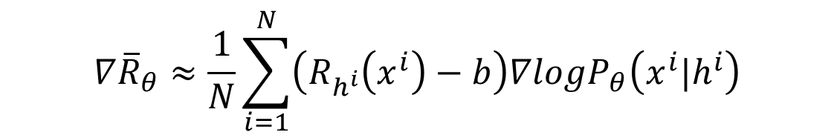

Reinforcement Learning?
Consider the output of discriminator as reward
Update generator to increase discriminator = to get maximum reward
Different from typical RL
The discriminator would update
En
De
Discrimi
nator
scalar
Chatbot
update
reward
$$∇{\overline{R}}_{θ}≈\frac{1}{N}\sum_{i=1}^{N}{\left(R_{h^{i}}\left(x^{i}\right)−b\right){∇logP}_{θ}\left(x^{i}|h^{i}\right)}$$
$$D\left(h^{i},x^{i}\right)$$
Discriminator Score
Notes:
The score of current utterances being human-generated ones assigned by the discriminator is used as a reward for generator, which is trained to maximize the expected reward of generated utterances using REINFORCE algorithm.
Actor critic

Slide 31



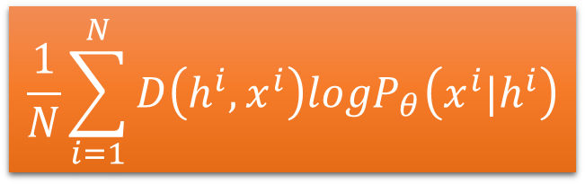








g-step
discriminator
New Objective:
$$θ^{t}$$
$$\frac{1}{N}\sum_{i=1}^{N}{D\left(h^{i},x^{i}\right){logP}_{θ}\left(x^{i}|h^{i}\right)}$$
$$\left(h^{1},x^{1}\right)$$
$$D\left(h^{1},x^{1}\right)$$
$$θ^{t+1}←θ^{t}+η∇{\overline{R}}_{θ^{t}}$$
$$\left(h^{2},x^{2}\right)$$
$$D\left(h^{2},x^{2}\right)$$
……
……
$$\frac{1}{N}\sum_{i=1}^{N}{D\left(h^{i},x^{i}\right){∇logP}_{θ^{t}}\left(x^{i}|h^{i}\right)}$$
$$\left(h^{N},x^{N}\right)$$
$$D\left(h^{N},x^{N}\right)$$
d-step
discriminator
$$x$$
$$h$$
fake
real

Slide 32











Reward for Every Generation Step
$$∇{\overline{R}}_{θ}≈\frac{1}{N}\sum_{i=1}^{N}{\left(D\left(h^{i},x^{i}\right)−b\right){∇logP}_{θ}\left(x^{i}|h^{i}\right)}$$
$h^{i}$ = “What is your name?”
$D\left(h^{i},x^{i}\right)−b$ is negative
$x^{i}$ = “I don’t know”
Update $θ$ to decrease $logP_{θ}\left(x^{i}|h^{i}\right)$
$logP_{θ}\left(x^{i}|h^{i}\right)=logP\left(x_{1}^{i}|h^{i}\right)+logP\left(x_{2}^{i}|h^{i},x_{1}^{i}\right)+$ $logP\left(x_{3}^{i}|h^{i},x_{1:2}^{i}\right)$
$$P\left("I"|h^{i}\right)$$
$h^{i}$ = “What is your name?”
$D\left(h^{i},x^{i}\right)−b$ is positive
$x^{i}$ = “I am John”
Update $θ$ to increase $logP_{θ}\left(x^{i}|h^{i}\right)$
$logP_{θ}\left(x^{i}|h^{i}\right)=logP\left(x_{1}^{i}|h^{i}\right)+logP\left(x_{2}^{i}|h^{i},x_{1}^{i}\right)+$ $logP\left(x_{3}^{i}|h^{i},x_{1:2}^{i}\right)$
$$P\left("I"|h^{i}\right)$$

Slide 33







Reward for Every Generation Step
$h^{i}$ = “What is your name?”
$x^{i}$ = “I don’t know”
$logP_{θ}\left(x^{i}|h^{i}\right)=logP\left(x_{1}^{i}|h^{i}\right)+logP\left(x_{2}^{i}|h^{i},x_{1}^{i}\right)+$ $logP\left(x_{3}^{i}|h^{i},x_{1:2}^{i}\right)$
$$P\left("I"|h^{i}\right)$$
$$P\left("don′t"|h^{i},"I"\right)$$
$$P\left("know"|h^{i},"I don′t"\right)$$
$$∇{\overline{R}}_{θ}≈\frac{1}{N}\sum_{i=1}^{N}{\left(D\left(h^{i},x^{i}\right)−b\right){∇logP}_{θ}\left(x^{i}|h^{i}\right)}$$
$$∇{\overline{R}}_{θ}≈\frac{1}{N}\sum_{i=1}^{N}{\sum_{t=1}^{T}{\left(Q\left(h^{i},x_{1:t}^{i}\right)−b\right){∇logP}_{θ}\left(x_{t}^{i}|h^{i},x_{1:t−1}^{i}\right)}}$$
Method 1. Monte Carlo (MC) Search
Method 2. Discriminator For Partially Decoded Sequences

Slide 34

















Monte Carlo Search
How to estimate $Q\left(h^{i},x_{1:t}^{i}\right)$?
$$Q\left("What is your name?","I"\right)$$
A roll-out generator for sampling is needed
$$h^{i}$$
$$x_{1}^{i}$$
$$x^{A}=$$
I am John
$$D\left(h^{i},x^{A}\right)$$
$$=1.0$$
$$x^{B}=$$
I am happy
$$D\left(h^{i},x^{B}\right)$$
$$=0.1$$
$$Q\left(h^{i},"I"\right)=0.5$$
$$x^{C}=$$
I don’t know
$$D\left(h^{i},x^{C}\right)$$
$$=0.1$$
$$x^{D}=$$
I am superman
$$D\left(h^{i},x^{D}\right)$$
$$=0.8$$
avg
Notes:
A lot of computing power is needed

Slide 35


Rewarding Partially Decoded Sequences
Training a discriminator that is able to assign rewards to both fully and partially decoded sequences
Break generated sequences into partial sequences
h=“What is your name?”, x=“I am john”
h
Dis
scalar
h=“What is your name?”, x=“I am”
x
h=“What is your name?”, x=“I”
$$Q\left(h,x_{1:t}^{}\right)$$
h=“What is your name?”, x=“I don’t know”
h=“What is your name?”, x=“I don’t”
h
Dis
$$x_{1:t}^{}$$
h=“What is your name?”, x=“I”

Slide 36




Teacher Forcing
The training of generative model is unstable
This reward is used to promote or discourage the generator’s own generated sequences.
Usually It knows that the generated results are bad, but does not know what results are good.
Teacher Forcing
Training Data for SeqGAN:
$$\left\{\left(h^{1},x^{1}\right),…,\left(h^{N},x^{N}\right)\right\}$$
Obtained by sampling
weighted by $D\left(h^{i},x^{i}\right)$
Adding more Data:
$$\left\{\left(h^{1},{\hat{x}}^{1}\right),…,\left(h^{N},{\hat{x}}^{N}\right)\right\}$$
Real data
Consider $D\left(h^{i},{\hat{x}}^{i}\right)=1$

Slide 37
Experiments in paper
Sentence generation: Synthetic data
Given an LSTM
Using the LSTM to generate a lot of sequences as “real data”
Generator learns from the “real data” by different approaches
Generator generates some sequences
Using the LSTM to compute the negative log likelihood (NLL) of the sequences
Smaller is better

Slide 38


Experiments in paper - Synthetic data

Slide 39


Slide 40

Experiments in paper - Real data

Slide 41

Results - Chat-bot
Notes:
It did not show great performance on machine translation and abstractive sumarizaion task.
Maybe because adversarial training strategy is more beneficial to
Tasks in which there is a big discrepancy between the distributions of the generated sequences and the reference target sequences
Tasks in which input sequences do not bear all the information needed to generate the target
in other words, there is no single correct target sequence in the semantic space.

Slide 42
To Learn More …

Slide 43





Algorithm – MaliGAN
Maximum-likelihood Augmented Discrete GAN
Initialize generator Gen and discriminator Dis
In each iteration:
Sample real sentences $x$ from database
Generate sentences $\tilde{x}$ by Gen
Update Dis to maximize
Update Gen by gradient
$$\sum_{x}{logD\left(x\right)}+\sum_{\tilde{x}}{log\left(1−D\left(\tilde{x}\right)\right)}$$
$$\frac{1}{N}\sum_{i=1}^{N}{\left(\frac{r_{D}\left(x^{i}\right)}{\sum_{i=1}^{N}{r_{D}\left(x^{i}\right)}}−b\right){∇logP}_{θ}\left(x^{i}\right)}$$
$$r_{D}\left(x^{i}\right)=\frac{D\left(x^{i}\right)}{1−D\left(x^{i}\right)}$$
$$D\left(h^{i},x^{i}\right)$$
Notes:
Gen is pre-trained by typical approach
Not gradient!

Slide 44
To learn more ……
Professor forcing
Alex Lamb, Anirudh Goyal, Ying Zhang, Saizheng Zhang, Aaron Courville, Yoshua Bengio, “Professor Forcing: A New Algorithm for Training Recurrent Networks”, NIPS, 2016
Handling discrete output by methods other than policy gradient
MaliGAN, Boundary-seeking GAN
Yizhe Zhang, Zhe Gan, Lawrence Carin, “Generating Text via Adversarial Training”, Workshop on Adversarial Training, NIPS, 2016
Matt J. Kusner, José Miguel Hernández-Lobato, “GANS for Sequences of Discrete Elements with the Gumbel-softmax Distribution”, arXiv preprint, 2016

